Slide 1
Lecture 4

Slide 2
THE TRIAL BALANCE
A trial balance is a list of balances both debit and credit as extracted from the ledger at a particular period.
We need to check and see that from each debit entry, there was a corresponding credit entry. In order to do that, we prepare a TRIAL BALANCE.
A trial balance is drawn by listing or entering the balancing figures in the ledger accounts. Depending on the side where the balance is carried forward from, the entry in the trial balance is entered as a debit or a credit

Slide 3
Preparing a Trial Balance
In the trial balance, the total debits should be equal to the total credits. If the two are different, it is an indicator of an error.
From the foregone example, extract a trial balance...
List the ledger account balances in two columns on the trial balance
Left column = Debits
Right column = Credits
Trial balance proves DR = CR

Slide 4
The Balancing of Accounts, The Trial Balance & Financial statements
Introduction:
In the previous exercise , you have learned the principles of double entry and how to post to the ledger accounts. The next step in our progress towards the financial statements is the trial balance.
Before transferring the relevant balances at the year end to the financial statements, it is usual to test the accuracy of the double entry bookkeeping records by preparing a trial balance.
This is done by taking all the balances on every account. Due to the nature of double entry, the total of the debit balances will be exactly equal to the total of the credit balances.

Slide 5
The Balancing of Accounts & The Trial Balance
Question: Once you have closed all the accounts, what would do?
Answer: Prepare a Trial Balance
Question: What is a Trial Balance then? What is it for? How does it look like?
Answer: A Trial Balance is a list of nominal ledger account and their balances at a given date.
It is usually prepared on the last day of the accounting period.
It consists of a Debit and a Credit balance.

Slide 6
Its purposes:
(1) It is prepared to check that the total of debit balances is the same as the total of credit balances and offer reassurance that the double entry recording from day books has been done correctly.
(2) For preparation of statement of income and the statement of financial position.

Slide 7
The Balancing of Accounts & The Trial Balance
The rules to prepare the Trial Balance:
Total Debit Entries = Total Credit Entries
Debit | Credit
Assets Expenses Drawings | Income/ Revenue Liabilities Capital

Slide 8
The Balancing of Accounts & The Trial Balance
Steps to preparing the Trial Balance:
Balance/cast ALL the ledger accounts in the books.
List all the Debit balances on the debit side and add them up.
List all the Credit balances on the credit side and add them up.
Ideally the trial balance should balance after step 3.

Slide 9
The Balancing of Accounts & The Trial Balance
What if the trial balance shows unequal debit and credit balances?
If the columns of the trial balance are not equal, there must be an error in recording or processing the transactions.
Four (4) Errors revealed by the trial balance:
The errors revealed are those errors which cause the Trial Balance totals to disagree. (i.e do not balance)
There are FOUR types of errors revealed by a trial balance: 4) Omission of one entry.
1) Posting to the wrong side of an account.
2) Errors in calculation and balancing.
3) Incorrect amounts entered on one entry.

Slide 10
The Balancing of Accounts & The Trial Balance
Question: How do we locate all of the above errors?
Answers:
1) Check day-book (journal) totals.
2) Check additions of Ledger accounts, ensure each balance is correct.
3) Check all ledger account balances have been recorded in the Trial Balance.
4) Check all balances have been entered in the Trial Balance on the correct side.
5) Check additions have been done correctly.

Slide 11
The Balancing of Accounts, & The Trial Balance
Question: Once you are sure there is no mistake made in the Trial Balance, what do you do in the next step?
Answers: Prepare End of Period Adjustment & then prepare the following statements:
1) Statement of Income
2) Statement of Financial Position
In short, these are the steps:
1) Trial Balance
2) End of Period Adjustments
3) Statement of Income
4) Statement of Financial position

Slide 12
The Balancing of Accounts & The Trial Balance
However, a trial balance will not disclose the following types of errors: (Errors not revealed by the trial balance)
1) Errors of omission
Complete omission of a transaction, because neither a debit nor a credit is made.
2) Errors of commission
This happens when original figure incorrectly entered. (Correct double entries but incorrect amounts were recorded)

Slide 13
The Balancing of Accounts & The Trial Balance
3) Compensating errors
This happens where errors cancel out each other. (eg an error of £100 is exactly cancelled by another £100 error elsewhere).
4) Errors of principles
This happens when the wrong type of account had been used (eg the purchase of a motor van is debited to a expense account, such as motor expenses, rather than a fixed asset account).
5) Complete reversal of entries
This happens when an account should be debited but was credited (and vice versa).

Slide 14
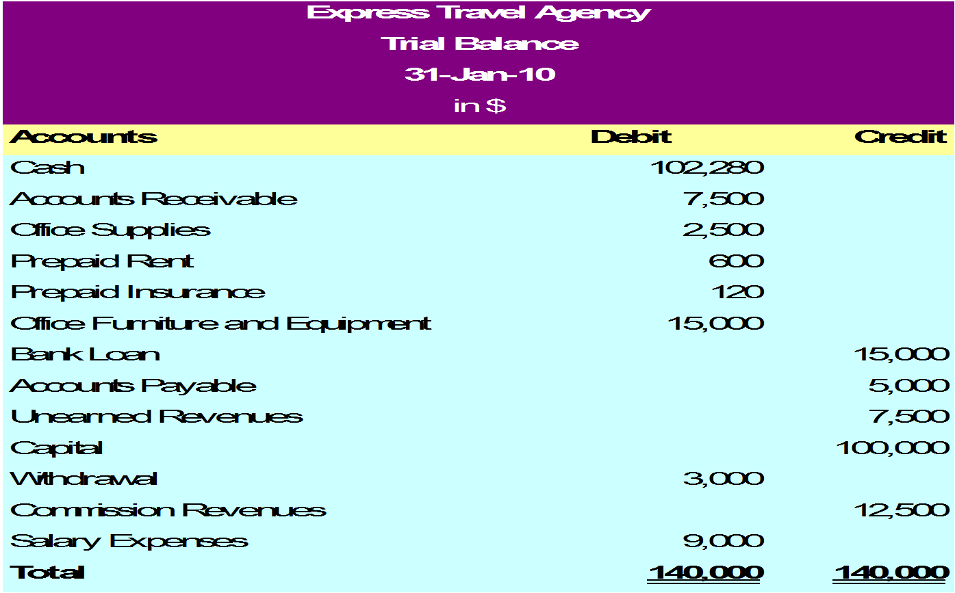
The Trial Balance

Slide 15
Example:

Slide 16
Cont,

Slide 17
Financial Statements for a Sole Trader
The major financial statements we shall consider here are the income statement, the balance sheet and the cash flows.
THE INCOME STATEMENT
This is a report that tells the profits/losses of the business for a period of time. It involves grouping of revenues and expenses prior to bringing them together to compute profit/loss. It is at times called the trading, profit and loss account if it is prepared to show the gross profit and the net profit.

Slide 18
Gross profit
This is the difference between the sales and the cost of the goods that have sold. If sales are more than the cost of sales , it results into gross profit. If cost of sales is more than sales, it results in gross loss. The part of the statement that calculates gross profit is called the trading account.
The cost of goods should be for only goods that have been sold. Therefore, the opening and closing stock of good should be considered.
Cost of goods sold is computed as
Opening stock of goods + Goods purchases during the period – Closing stock of goods.

Slide 19
The net profit:
The net profit is computed in the profit and loss account. It is computed as:
Gross profit + other revenues other than from sale of goods – expenses incurred during the period.

Slide 20
Format

Slide 21
THE BALANCE SHEET

Slide 22
Liabilities:

Slide 23
Cont,

Slide 24
Example:
From the trial balance below of Mukasa ENT extracted after one year of trading on 31/12/08, prepare an income statement and the balance
Mukasa Ent.
Trial balance extracted as at 31/12/08

Slide 25
Cont,

Slide 26
Cont,

Slide 27
Cont,

Slide 28
NOTES
Return inwards are deducted from sales.
Return out wards are deducted from purchases.
Carriage in ward is always added to cost of goods in the trading account.
Carriage out ward is always treated as an expenses and therefore lessed from gross profit.
When Sales and purchases are put on the sale line in the trial balance, the figure in the debit column is for purchases and that in the credit column is for Sales.

Slide 29
When accounts payable are put on the same line in the trial balance, the debit is for accounts receivable while the credit 2is for accounts payable.
Similarly, return inwards is on the debit side and return out word is on the credit.
If cash at bank figure appears on the credit side, it means an overdraft and therefore current liability.

Slide 30
Exercise:

Slide 31
ADJUSTMENTS FOR FINANCIAL STATEMENTS

Slide 32
CAPITAL AND REVENUE EXPENDITURE
Capital expenditure is incurred when a business spends money either to buy non current asset or add value to non current assets. E.g. price of buying the asset cost of bringing it to use, legal and consultancy fees, carriage of machines.
Revenue expenditure is expenditure incurred on running the business on the day to day basis. E.g. p aying rent, fuel for the car and car repairs.
Capital expenditure is added to the value of the fixed asset and taken to the balance sheet, where as revenue expenditure is treated as an expense and taken to the profit and loss account.
Loan interest is treated as a capital expenditure if the loan is used to acquire a non current asset.

Slide 33
BAD DEBTS & PROVISION FOR BAD DEBTS
Bad debts are the amount of debtors that are uncollectible. It is normal in business that some debtors fail to pay their accounts.
Bad debts are treated as expenses and charged to profit and loss and the debtor’s account is closed.
To record, you credit the debtor’s account to council the asset and increase expenses buy debiting the bad debt account.
Provision for bad debts is an allowance for debtors that may become bad in future.

Slide 34
When writing books of accounts, you may not tell the debtors who will fail; to pay but it is likely that some of them may not pay. So an estimate is made for debtors who may fail to pay. The estimated figure is arrived at by:
The experience of the percentage of debtor who do not pay.
By examine debtor’s conditions on individual basis.

Slide 35
Cont,
The accounting entries for doubt full debts:
In the year in which the allowance is being made for the first time;
Debit profit and loss account with the amount of the allowance
Credit allowance for doubt full debts accounts
In the income statement, allowance for doubt full debts is treated as an expense. In the balance sheet, allowance for doubt full debts is deducted from debtors.
Increasing provision/ allowance for bad debt
If the provision for doubt full debts is increased, the accounting treatment is:

Slide 36
Cont,
Dr. Profit and loss account with increase.
Cr. The allowance for doubt full debts.
Reducing the provision for doubt full debts, the accounting entries are:
Dr. Provision for doubtful debts.
Cr. Profit and loss account.
E.g. A business started on 1/1/07 and its accounting year ends on every 31st Dec. The table below relates to its bad debts, debtors net of bad debts and the provision for bad debts.

Slide 37
Cont,

Slide 38
Bad debts recovered
Some times, the debts that had been written off could be recovered. If this happens,
Dr. Debtor’s account (reinstate).
Cr. Bad debts recovered account.
The bad debts recovered are transferred to the credit of profit and loss account.

Slide 39
PROVISION FOR CASH DISCOUNT
Some businesses may create a provision for cash discount on debtors where debtors who settle their accounts in time get discounts.
The accounting treatment for cash discounts is similar to that of provision for bad debts.

Slide 40
ACCRUALS AND PREPAYMENTS
ACCRUALS
Accruals are expenses consumed within the accounting period but remain unpaid at the end of the period (at the time of the preparing financial statement.)
For example, the rent that appears in the trial balance is that that has been paid with the year. There could be rent that was not paid for at the beginning of the period or at the end of the year. The figure to be taken to the income statement as rent expense need to be adjusted for both opening and closing rent unpaid.

Slide 41
Cont,
If there is opening expense unpaid for, it means it will be paid for in the course of the year and therefore the amount paid for the expense during the year includes amount for the expense relating to the previous year.
Opening accruals should therefore be subtracted from the trial balance figure.

Slide 42
Cont,

Slide 43
Example:

Slide 44
PREPAYMENTS (ADVANCES)

Slide 45
Cont,
Example: On 31st Dec 2007, rent owing was 3,000,000=. The rent chargeable for the year is shs 12,000,000=.
The following rent payments were made during 2008; Jan 1st shs 3,000,000 1st April 3,000,000 July 3,000,000. Draw up rent account.

Slide 46
Example:
Jamwa has been trading for years as a wine merchant.
The following list of balances were extracted from his ledgers as at 31st Dec 2008.

Slide 47
Cont,

Slide 48
Cont,

Slide 49
Thank You…………………….!!!

